Slide 1
Car parking
AOSE Project

Slide 2
Project idea
Develop a multi-agent system based on a parking system.
Each car have to park in a predefined slot.
Each car does not know if there are other cars and where they are.
There are normal cars and slower cars.

Slide 3
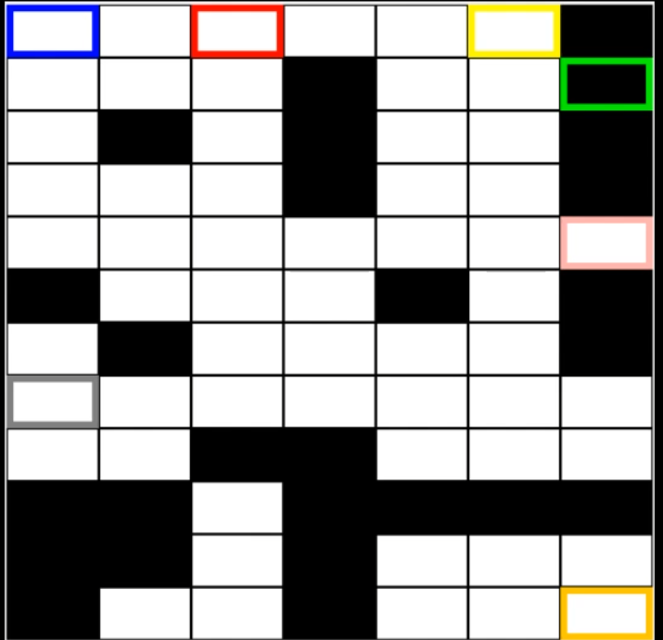
Environment
The parking structure is defined as a grid and can contain:
Fixed obstacles
Cars
Slow cars
Parking slots

Slide 4
Agents - Car
A car is a type of agent which has to reach its goal.
The goal for a car is to park itself in a specified slot which has been defined inside the problem.
A car can:
Move left
Move right
Move up
Move down
Check the environment

Slide 5
Agents - Slow car
A slow car is a special type of car which needs to wait before performing a move action.
The goal for a car is to park itself in a specified slot which has been defined inside the problem.
A slow car can:
Move left and wait
Move right and wait
Move up and wait
Move down and wait
Wait
Check the environment

Slide 6
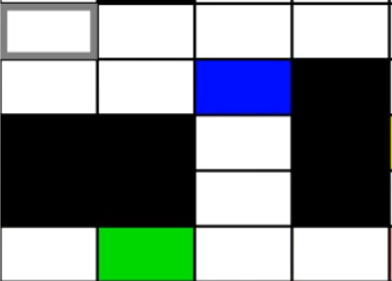
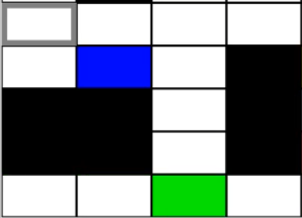
Actions - Move (up down left right)
A move action consists in moving a car in a direction in order to reach its goal.
Before moving, a car has to check if there is enough space where it wants to move, in order to avoid crashes against cars.

Slide 7
Actions - Move and wait (up down left right)
A move and wait action consists in moving a slow car in a direction in order to reach its goal.
Before moving, a slow car has to check if there is enough space where it wants to move, in order to avoid crashes against cars.
After each move a slow car has to perform a wait action, in order to “slow” the car.

Slide 8
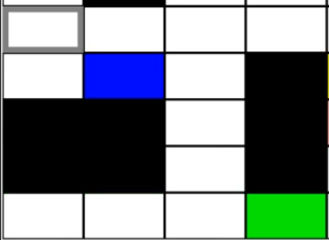
Action - Wait
This action is used to “slow” a slow car in order to let “faster” cars perform more move actions.
W

Slide 9
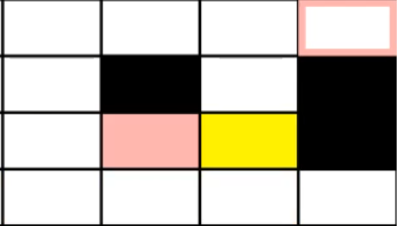
Check the environment
Before moving, each car checks if there is no problem on moving in order to avoid crashes.
It is possible by checking the environment on the “next” position if there is another car.
What happens if a car cannot move?

Slide 10
Recalculate path
If a car finds another car on its path, it stops and recalculates another path.
Then two option can occur:
New path found → Follow the new path
No path found → Try to recalculate again
Why recalculate again?
A car could have moved unlocking a new path. If no way are found it will recalculate at most 10 times before aborting if there are no options.

Slide 11
Pros and cons
Pros
Cars are independent
Car checks before moving
Car recalculates plan
Cons
Cars can check only near themselves
Car forgets about the others

Slide 12
Further useful implementation
Check further to find other cars.
Define directional routes.
Ask for shifting to active cars.

Slide 13
Summary
Environment agent notifies each car of the static structure of the parking system.
Each car receives its goal.
Each car calculates a plan to reach its goal.
Before moving (intention), each car checks if there is another car on its way (sensing).
If a car is found, updates beliefs and recalculates a new plan.
Slow car needs to wait before performing another move action.

Slide 14
Video
Fast cars
c0
c4
c5
Slow cars
c1
c2
c3
c6

Slide 15
Thank you for the attention

